Slide 1
Step 5: Coordination, Control & Information Systems
Section 9: Coordination, control, and information systems
Yağmur ERTAŞ

Slide 2
Outline
Introduction
Coordination and control systems
Family
Machine
Market
Clan or mosaic

Slide 3
Introduction
We have designed the processes and people based systems to support our organizational structure.
Now, it’s time to design coordination, control and IS to manage links between parts within the organization.

Slide 4
Introduction (con’t)
Coord., ctrl. and IS support integration of the organization and they provide monitoring for decision making.
Prior to computer era, coord. and ctrl. systems were entirely manually based.
Today, both computer based and manual methods are in use.

Slide 5
Introduction (con’t)
These methods may be visible (reports and established routines) or invisible (informal).
Together, coord., ctrl. and IS constitute the infrastructure of the firm for information sharing.

Slide 6
Coordination and control systems
Early on in the development of professional business organizations, managers gave dominant attention to developing control systems.
The role of middle management was to control information flow through management and workers.

Slide 7
Coordination and control systems (con’t)
Ctrl. systems allow top-level management to monitor sub-units by measuring their performance.
(e.g) - budget, production measurement, performance reviews

Slide 8
Coordination and control systems (con’t)
Coord. systems support flexibility and adaptiveness within and across departmental or divisional boundaries.
Shortly, coord. systems enable right hand to know what the left hand is doing.
(e.g) - cross-functional teams and committees, project man. systems (SAP, Movex, Navision)

Slide 9
Coordination and control systems (con’t)
To design coord. & ctrl. systems, it is useful to begin by making two fundamental choices;
How formalized do you want these systems to be?
How centralized should ctrl. and coord. be?

Slide 10
Coordination and control systems (con’t)
Formalization is the degree to which the organization specifies a set of rules or codes to govern how work is done.
(e.g) - formal rules, regulations
Formalization is high if these rules are very detailed.

Slide 11
Coordination and control systems (con’t)
Centralization is the degree to which coord. and ctrl. are managed by a core person or level of the organization, usually corporate head-quarters.
Usually high in the start-up firms and traditional bureaucracy.

Slide 12
Coordination and control systems (con’t)
Decentralization is the degree to which responsibility for coord. and ctrl. lies in the sub-units of the firm and individual managements.
Dimensions of formalization and decentralization are used to design options for coord. and ctrl. systems.

Slide 13
Coord. and ctrl. systems
Formalization
High
Clan
Machine
Mosaic
Low
Decentralization
High
Family
Market
Low

Slide 14
Family
Low formalization and decentralization.
Ctrl. systems are designed to rely on informal and centralized means of control.
Few written rules, people know what to do.
CEO or head manager dictates what is to be expected.
More flexible structure.

Slide 15
Machine
High degree of formalization and centralization.
Machine model systems are designed with documentation of rules and procedures.
Monitoring, feedback and correction systems are vital.

Slide 16
Machine (con’t)
Coord. and ctrl. systems can help the organization to operate as a smart /intelligent machine. (e.g Six Sigma QC, 360-degree feedback)
Wall-Mart has built excellent coord. and ctrl. systems for monitoring activities within the organization.
It can lack creativity and flexibility.

Slide 17
Market
Emphasizes on low formalization and high decentralization.
Overall approach is informal but budgeting & performance reviews may be formalized.
People encouraged to “speak up” and report problems.

Slide 18
Market (con’t)
There are variations in coord. and ctrl. across different departments or sub-units.
The market approach can be effective if done well, especially for promoting innovation.
Governance is relatively centralized, groups oversee themselves with high autonomy relative to HQ.

Slide 19
Clan or mosaic
If both decentralization and formalization are high, there are two possible approaches for designing coord. and ctrl. systems.
The clan model has greater formalization and less decentralization and uses strong norms to guide how work is done.

Slide 20
Clan or mosaic (con’t)
Rules for coordination and control are are communicated via extensive modeling by both workers and managers in discussion of “the way we do things”.
Southwest Airlines developed a very successful clan type of model which highly efficient and effective.
The “IKEA way” is another example.

Slide 21
Clan or mosaic (con’t)
The mosaic model has greater decentralization and less formalization than the clan model.
Coord. and ctrl. systems are not identical through the organization.
Common standards are minimized, an all remaining standards and methods are customized to meet the needs of sub-units.

Slide 22
Clan or mosaic (con’t)
Unilever takes a mosaic approach as it fosters heterogeneity across countries/regions and product lines.
If the coord. and ctrl. system is changed in one area, it is not necessary that the entire firm changes its system.
Mosaic model is difficult to achieve.

Slide 23
Information Systems
In addition to coordination and control, information systems are vital components of the infrastructure of the organization.
Coordination, Control →methods for governing how work is done
Information Systems → methods for providing meaningful data to decisionmakers

Slide 24
Information Systems
Although many factors can be used to determine the design of an organization’s information systems, here the book focus on two critical dimensions:
  Amount of information is overall volume of data that an organization must collect, process and store on a regular basis.
  The tacit nature of information cannot be seen and it is exchanged within the organization.

Slide 25
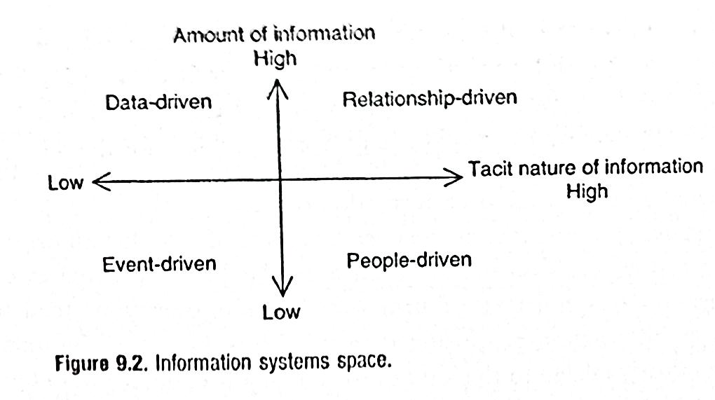
Information Systems
The two dimensions of amount of information and tacit nature of information suggest four general approaches to information systems design.

Slide 26
Event Driven
IF;
Information processing in a firm is low
The tacit nature of information is low
THEN;
→The firm can be designed using event-driven model

Slide 27
Event Driven
It means that systems are designed to process information associated with specific occasions of results as they occur.
Event-driven systems are reactive to needs as they arise.
Examples: Factual meetings, announcements and communication of directives from one location in the firm to another (CEO or manager).

Slide 28
Data Driven
It is for,
Low tacit nature information
High amount of information
As the amount of information to be processed is increases information system design should be Data-driven

Slide 29
Data Driven
Appropriate for the organizations which deal with high volumes of information.
Data-driven approach assumes that information can be readily captured and stored

Slide 30
People Driven
For,
Highly tacit information
Low amount of information processing
People-driven approach emphasizes capture, processing, and transfer of data that embeded in the minds and actions of people.

Slide 31
People Driven
People-driven dimension’s priority is to bring people together face-to-face so that they can share tacit knowledge.
Face-to-face meetings are a classic type of information sharing of tacit knowledge. If it is not possible; phone conversation, video conferancing etc. can be used.

Slide 32
People Driven
People-driven systems work well while the volume of information to be exchanced is not too high!
Example, can be a company that has developed a new venture in a line of bussiness that is unfamiliar to most involved.

Slide 33
Relationship Driven
Appropriate approach for;
High tacit nature information
High amount of information process

Slide 34
Relationship Driven
The most complex model because it has data-driven and people-driven elements
Emphasizes capture, processing and transfer of data that is embedded in the relationships between people and data

Slide 35
Relationship Driven
Example, the most well-known is customer relationship management (CRM) systems.
CRM systems capture large quantifiable data about customers but also provide interactive capabilities so that the salespeople can exchange unstructure observations.

Slide 36
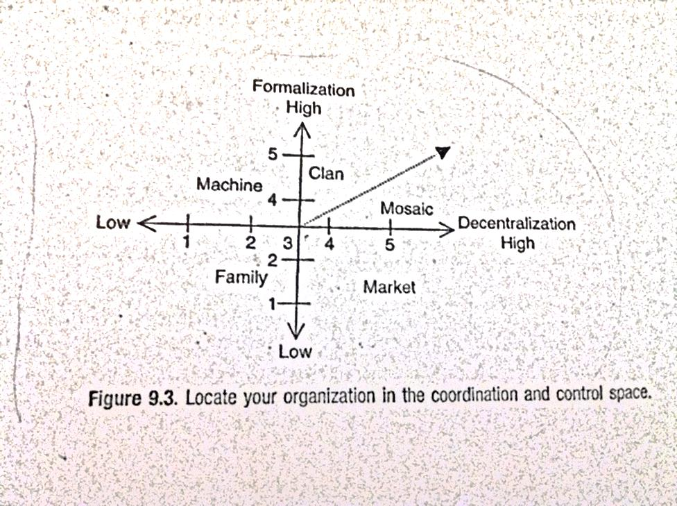
Diagnostic Questions
Consider your unit of analysis as a whole in answering these questions:
1. Examine the two dimensions in the figure:

Slide 37
Diagnostic Questions
2. Decentralization: to what extent does your organization govern work tasks, people and processes using a decentralized approach: very little(1) to great extent (5)
3. Formalization: to what does your organization use formalized methods of coordination and control: very little(1) to great extent (5)

Slide 38
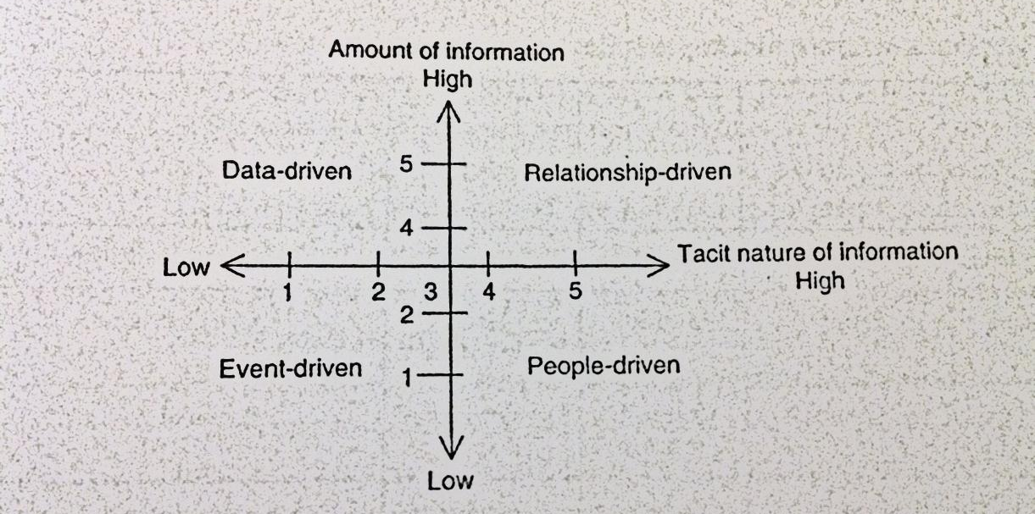
Diagnostic Questions
4. Examine the two dimensions in the figure:

Slide 39
Diagnostic Questions
5. Tacit nature of information: think about the kind of knowledge important for your organization’s success in doing everyday work.
6. Amount of information: What is overall volume of data that the organization must collect, process and store on a regullar basis: high or low?
***After answering these all, we can locate the organization and chose our model.

Slide 40
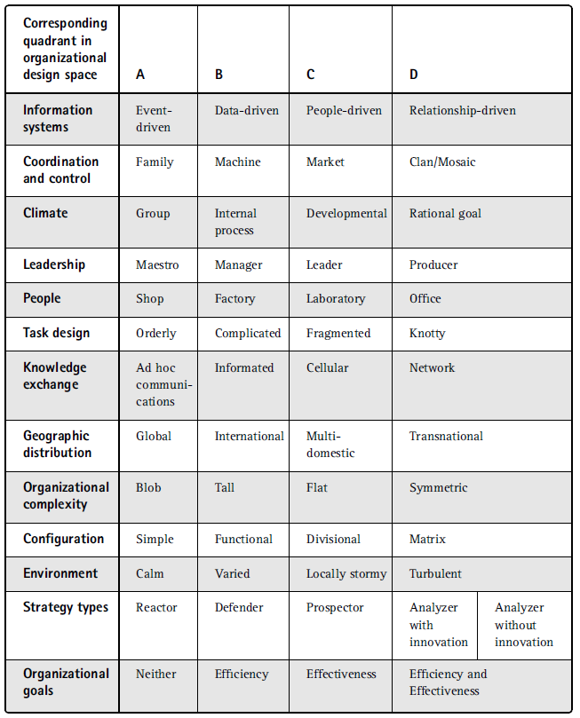
Fit and
Misfit

Slide 41
Fit and Misfit
A Simple
B Machine-based
C Innovative
D Leadership Style

Slide 42
Fit and Misfit
For example: in the column A approach,
IF;
Goals
Strategy
Environment
Configuration
People or work process lie under another column, misfit will arise! SO we should move to develop more sophisticated infrastructure!!

Slide 43
QUESTIONS ? ☺

